Slide 1
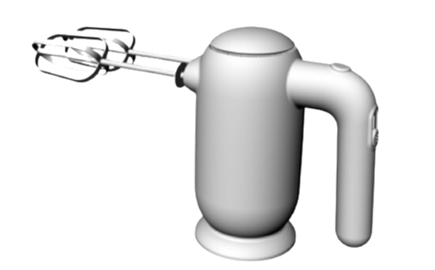

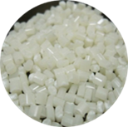
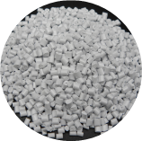

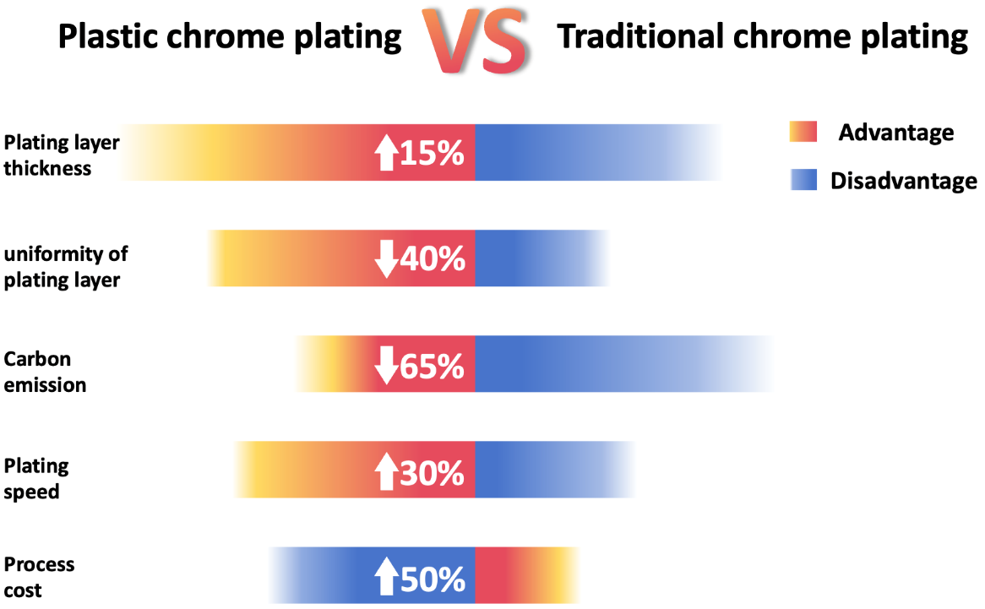

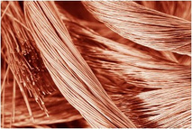
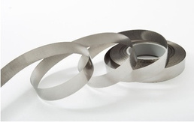
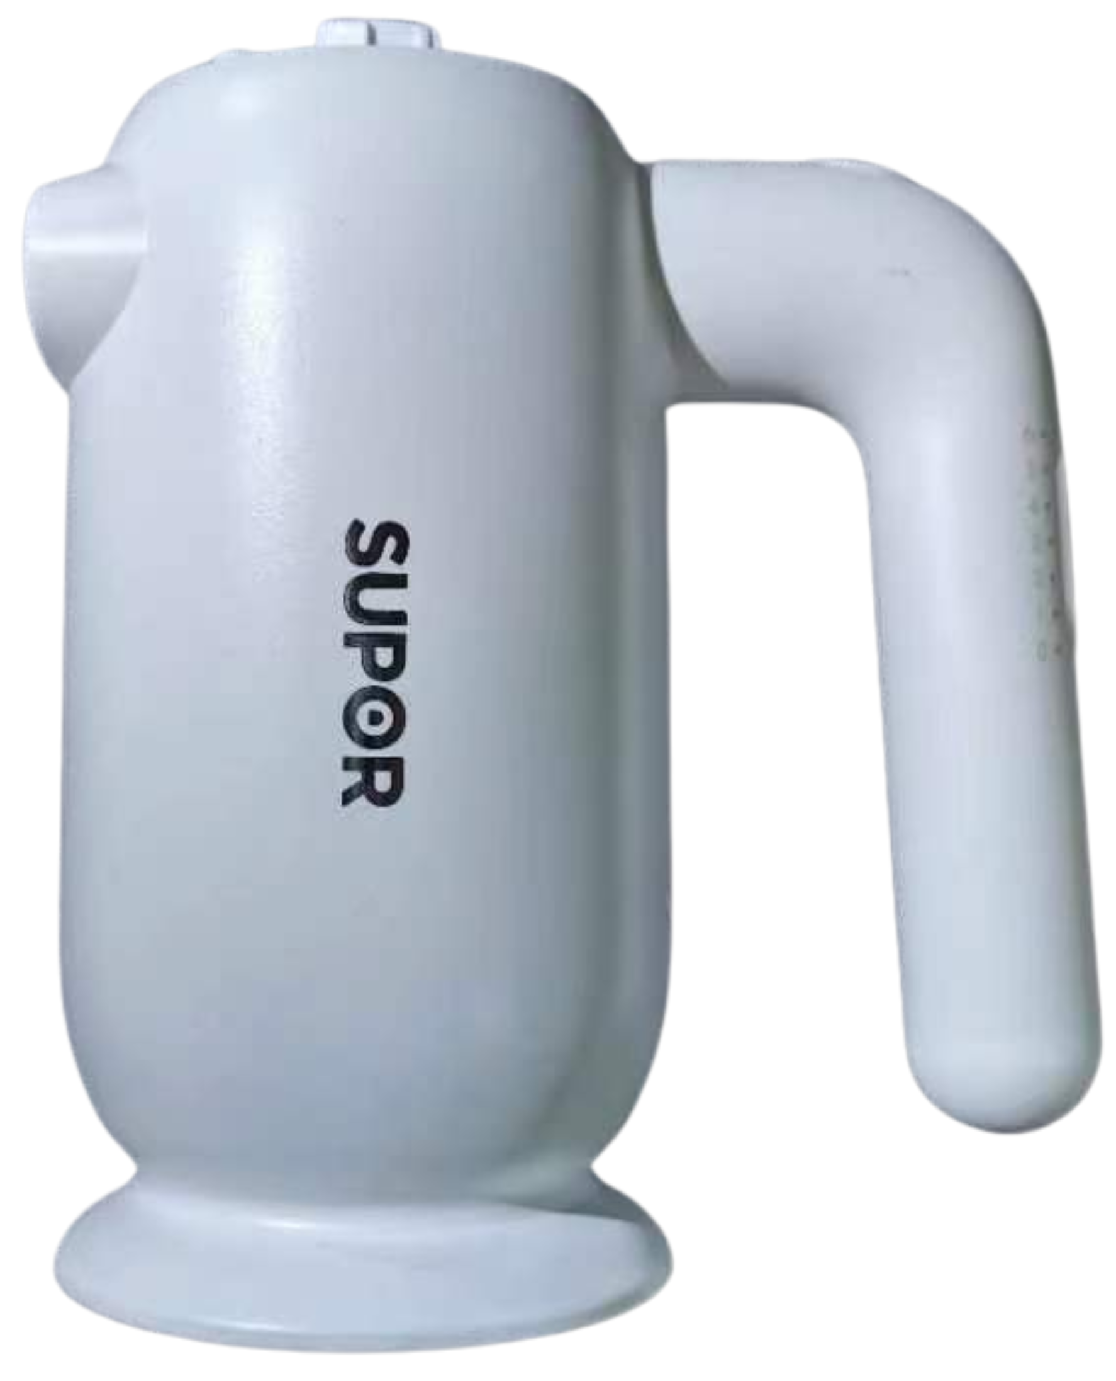
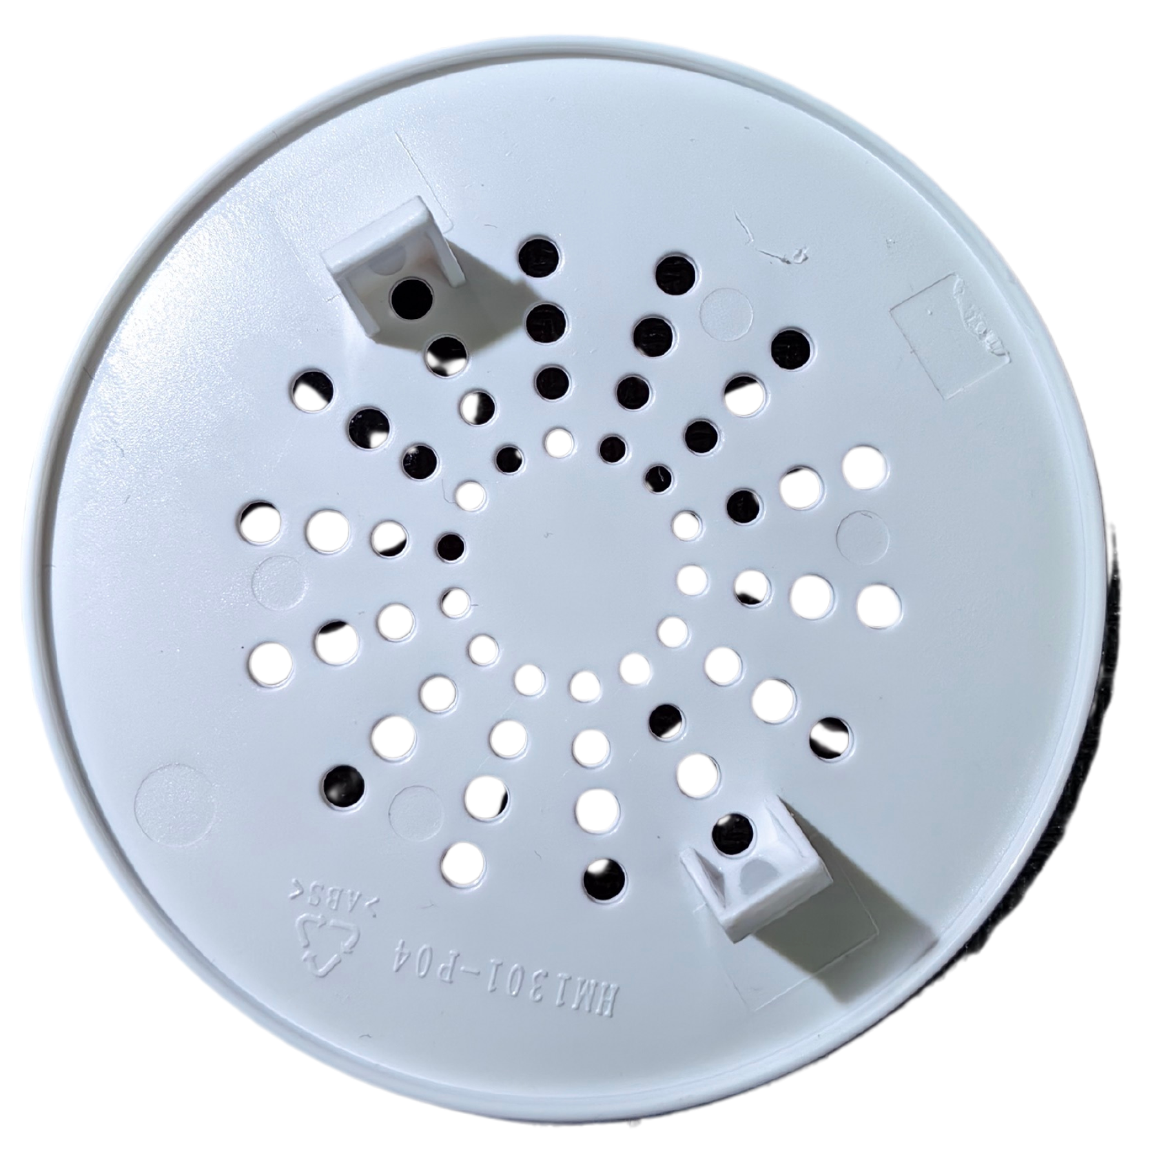
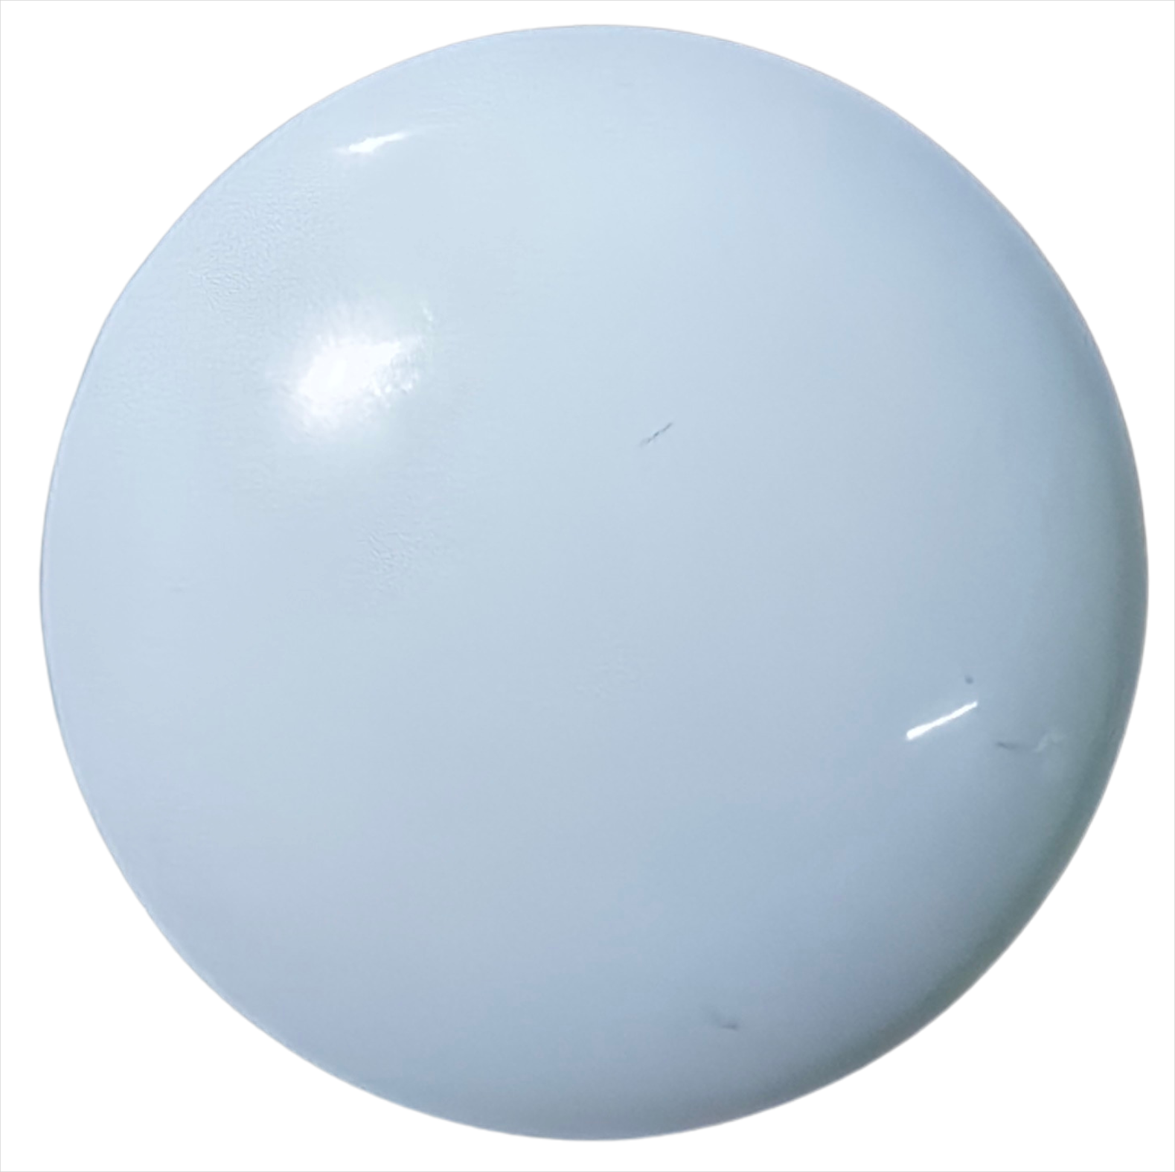
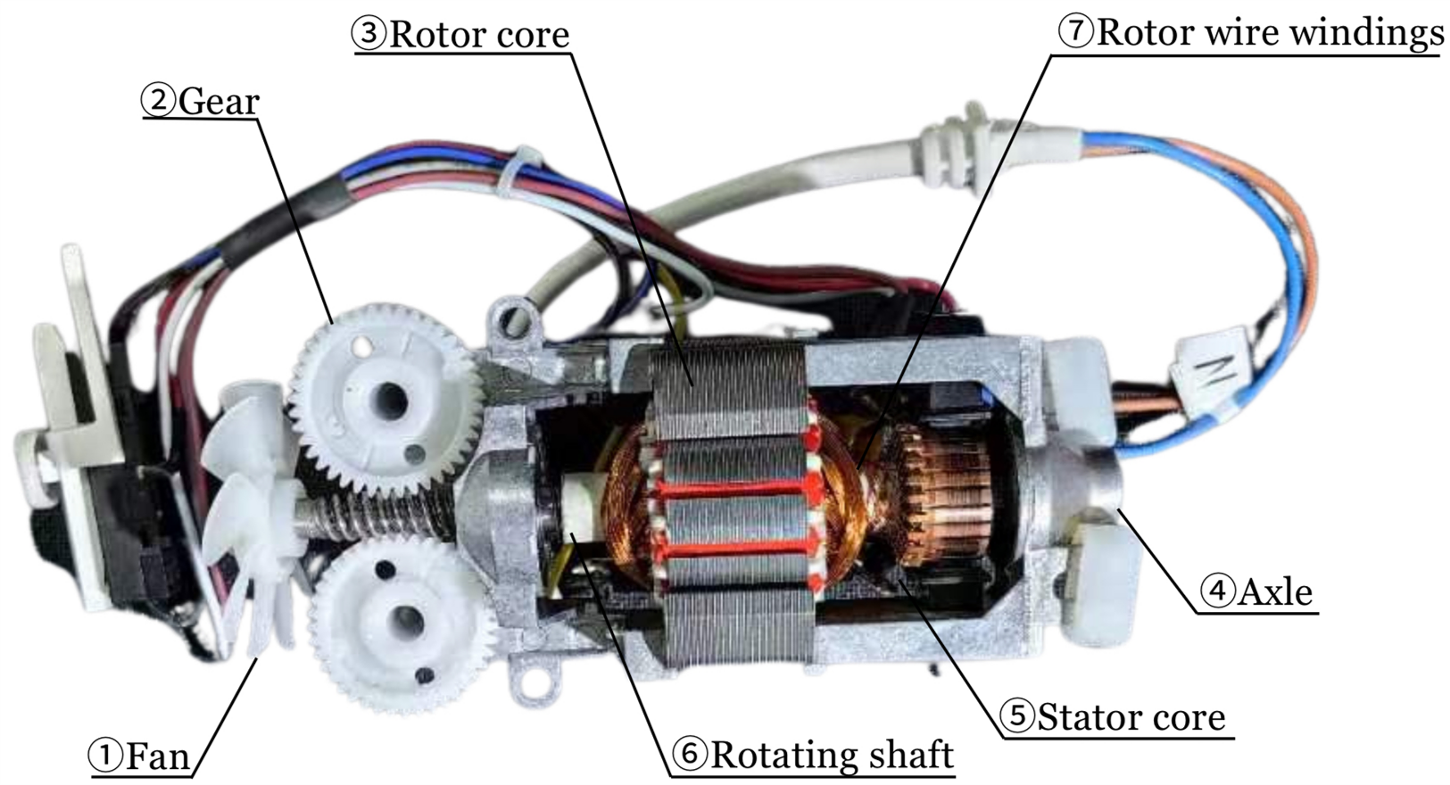
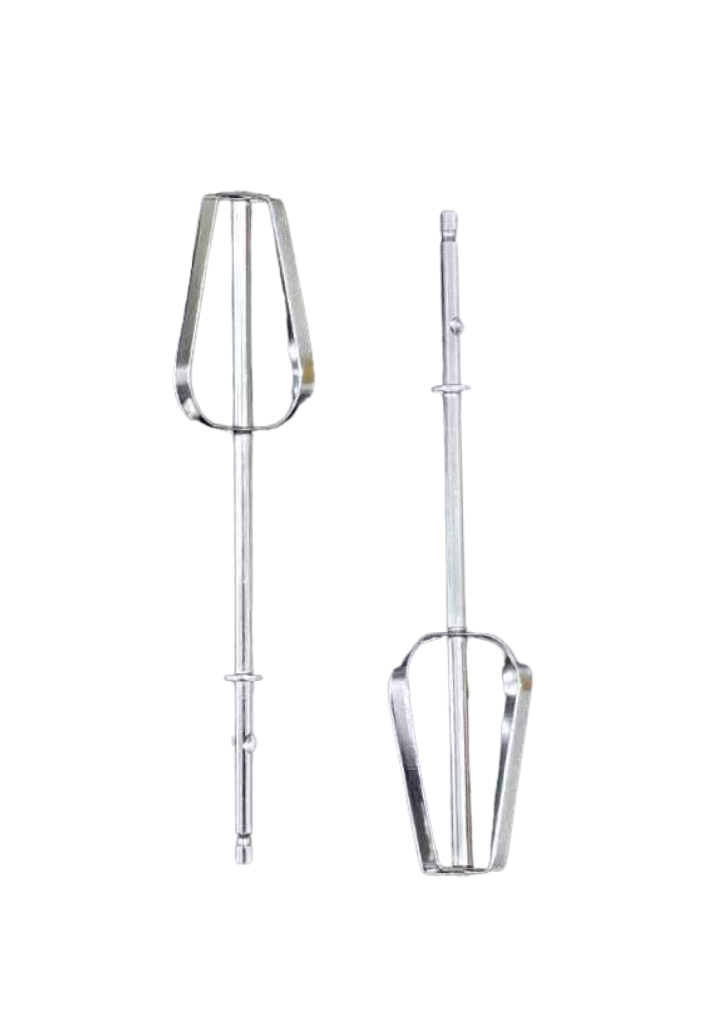
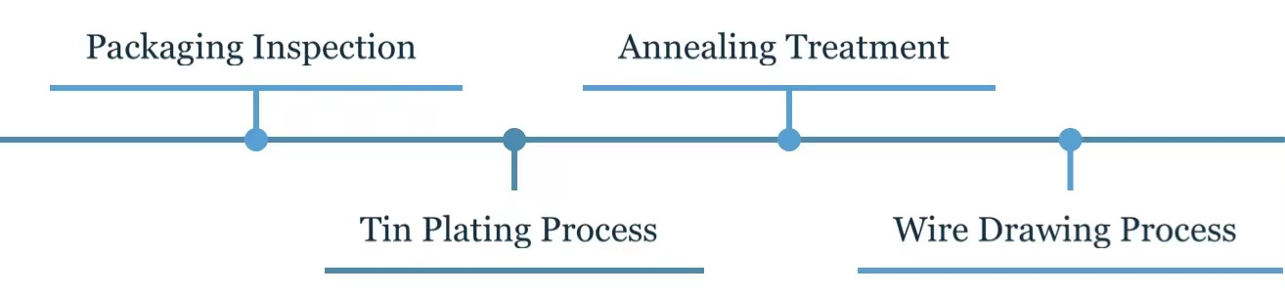
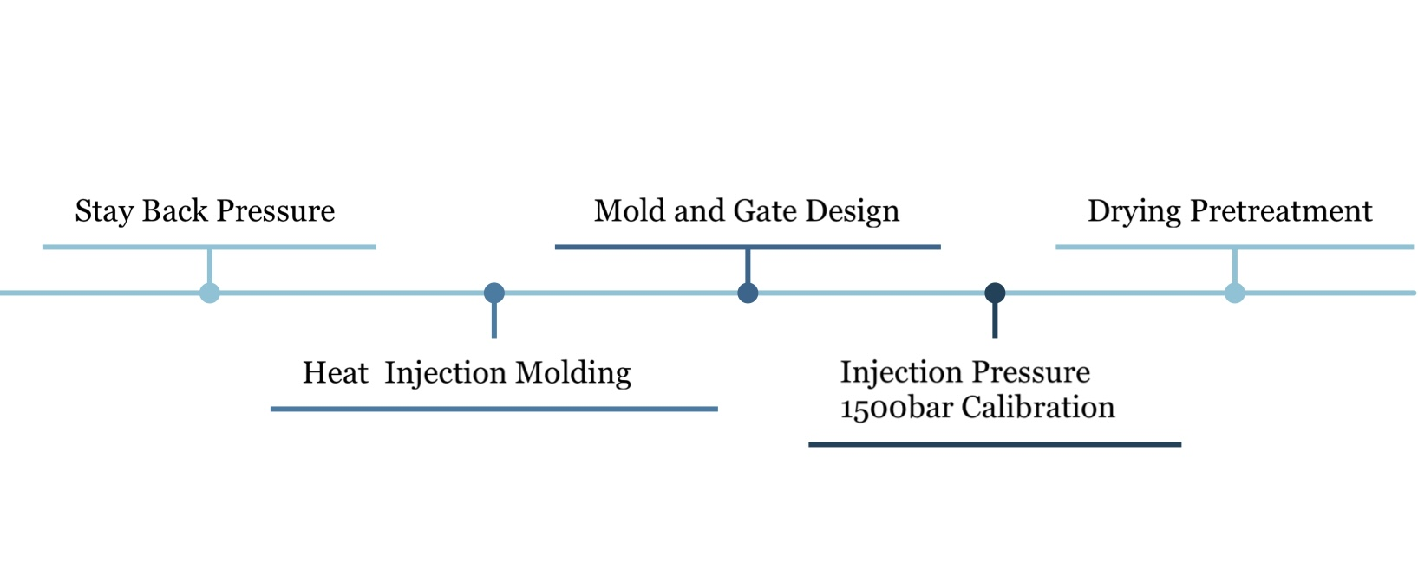
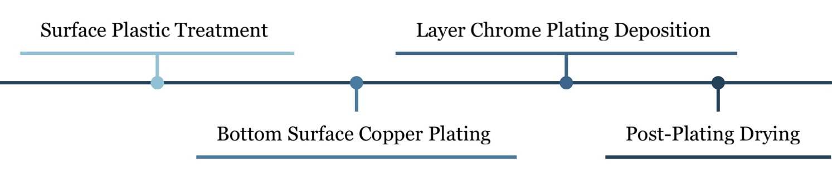
Whisking Towards a Greener Future: Revamping Electric Whisk for Eco-Friendly Innovation
Group number: M18
Group members: Xuanming Che, Ruihan Zhang, Haoyu Wu, Wenqing Cao, Tianshi Gao, Yongqi Xu
Introduction
Improvement
An electric whisk, a kind of small handheld device used to whip
ingredients are widely used in home kitchens and small workshops. Our competitor product the SUPOR electric whisk, due to its lightweight, 200W enough power and stir bar push-out button design, has positive feedback from the customers. However, shortages still exist in SUPOR electric whisk[1].
ABS
PC/ABS
Density
1.20
1.18
39.00
User requirement
Tensile Strength
60.00
Improved material[2]
87.00
97.00
Vicat Softening Point
Higher mechanical properties
Protection from UV Radiation
High Impact Strength
Chemical Resistance
Heat Resistance
Lightweight
170.00
80.00
User Requirement | Design Input |  | Out Put | Project Goal
Long Service Life | Heat resistance | ABS plastic shell | Good heat dissipation | For the shell, we are about to enhance heat dissipation capability. For the engine, a new material will be applied to save energy. For the rods, the coating process can be optimized for eco-friendliness.
 |  | Improved shell shape | Longer sustaining time
 | Energy saving | Copper wire | Good conductivity
 |  | Soft magnetism | Larger magnetic flux Smaller electrical losses
Environmentally Friendly | Process Environmental Protection | Traditional chrome plating | Durable, safe, and resistant to rusting
 |  | Plastic chrome plating | More affordable environmentally friendly
Mold Temperature
Outer shell
Improved manufacturing process[6}
Engine
Whisk Bar
Material &Property & Failure Mode
Copper
Calorific reduction
Soft Magnetism[10]
 | Figure | Meterial | Property | Failure mode
Outer shell |  | ABS[2][3] | Excellent mechanical properties: 1. High impact strength 2. Dimensional stability 3. Electrical insulation 4. Processability | High temperatures cause it to deform or lose its mechanical properties
Engine | ①
 | ②
 | ③ | Stainless Steel[9] | Excellent mechanical properties: 1. High strength 2. Corrosion resistance | 1. Tensile stress : Crack propagation welding failure 2. Temperature and humidity: Intergranular / crevice corrosion
 | ④
 | ⑤
 | ⑥ | Copper[6] | 1. High electrical conductivity 2. Malleability 3. Corrosion resistance | 1. Tensile strength: than 275 MPa 2. Elongation δ10 and δ5 are 5% and 10%
Whisk bar[6] |  | Chrome plating[7] | 1. Good corrosion resistance 2. Excellent wear resistance 3. Strong heat resistance | High-temperature steam environment, humid environment, pH change, chemical corrosion
 |  | Q195 food grade carbon steel | Malleability, weldability, rotting resistance, and plasticity | Tensile strength: 315-430 MPa, Elongation: ≥ 33%, Yield strength: 195 Mpa.
Energy loss reduction
The magnetic flux becomes larger
Improved material[6]
Improvement
Plastic Chrome
Plating[6]：
Surface Plastic Treatment
Bottom Surface Copper Plating
Post- Plating Drying
Layer Chrome Plating Deposition
① Fan
④ Axle
Sustainable
② Gear
⑤ Stator core
For the shell, the service life of the PC/ABS shell is generally 15 years[3], which is greatly extended[4]. By using the LCA method, the evaluation results show that the predicted carbon footprint is reduced by 8% compared to ABS[4].
For the material of the wire, soft magnetic materials can increase magnetic flux, convert more electrical energy into magnetic energy, and then convert it into mechanical energy, thereby reducing the generation and loss of thermal energy and achieving the goal of energy conservation and environmental protection[6][10].
For the rods, the metal surface is covered with a thin layer of special plastic followed by chrome plating, bringing significant data improvements. The coating thickness is increased by 15%, the surface uniformity variance is reduced by 40%, and the product quality is greatly improved. At the same time, the carbon footprint has been reduced by 65%, showing a high degree of environmental protection [7].
③ Rotor core
⑥ Rotating shaft
Manufacture
Reference
Packaging Inspection
Annealing Treatment
Copper
Coil[10]
[1] SUPOR, electric whisk, properties of household electric egg breaker, https://item.jd.com/100013382074.htm
l[2] ABS plastic: Advantages, disadvantages, and applications Protolabs. Available at: https://www.protolabs.com/materials/abs/ (Accessed: 29 May 2024).
[3] Xometry, T. (2022) Polycarbonate vs. ABS: Material differences and comparisons, Xometrys RSS. Available at: https://www.xometry.com/resources/materials/polycarbonate-vs-abs/
[4] Overview of materials for acrylonitrile butadiene styrene (ABS), extruded. Available at: https://www.matweb.com/search/DataSheet.aspx?MatGUID=3a8afcddac864d4b8f58d40570d2e5aa.
[5] The Online Materials Information Resource MatWeb. Available at: https://www.matweb.com/search/DataSheet.aspx?MatGUID=f95547ddf56e4cf9a7d94bf86d32525b&ckck=1
[6] Josefina M. Silveyra et al. ,Soft magnetic materials for a sustainable and electrified world.Science362,eaao0195(2018).DOI:10.1126/science.aao0195
[7] Metal finishing Mariola Brandes (https://www.sciencedirect.com/science/article/pii/S0026057607806118)
[8] HOW DOES INJECTION MOULDING WORK(https://www.rutlandplastics.co.uk/how-does-injection-moulding-work/)
[9] Martin Medňanský, Marek Brůna, Marek Matejka, Electromotor housing microstructure dependence on HPDC process parameters, Transportation Research Procedia, Volume 74, 2023, Pages 680-687, ISSN 2352-1465
[10] Abdelwahed Aamir, El alami Semma, Mohamed Amine Dabachi, Modeling and numerical simulation of soft ferromagnetic materials used in electrical machinery, Materials Today: Proceedings, Volume 30, Part 4,2020, Pages 942-950, ISSN 2214-7853
Tin Plating Process
Wire Drawing Process
ABS
Injection Process [8]
Stay Back Pressure
Mold & Gate Design
Drying Pretreatment
Heat Injection Molding
Injection Pressure Calibration
Surface Plastic Treatment
Layer Chrome Plating
Plastic Chrome Plating[7]
Bottom Surface Plating
Post-Plating Drying

Slide 2
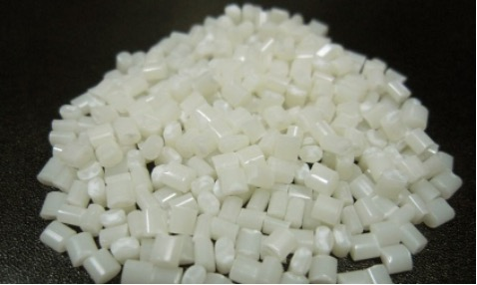
 | Figure | Meterial | Property | Failure mode
Outer shell |  | ABS | Excellent mechanical properties: 1. High impact strength 2. Dimensional stability 3. Electrical insulation 4. Processability | High temperatures cause it to deform or lose its mechanical properties
Engine | ①
 | ②
 | ③ | Stainless steel | Excellent mechanical properties: 1. High strength 2. Corrosion resistance 3. Plasticity, weldability | 1. Tensile stress : Crack propagation welding failure 2. Temperature and humidity: Intergranular / crevice corrosion
 | ④
 | ⑤
 | ⑥ | Copper | 1. High electrical conductivity 2. Good thermal conductivity 3. Malleability 4. Corrosion resistance | 1. Tensile strength: than 275 MPa 2. Elongation δ10 and δ5 are 5% and 10%
 | ⑦ | Ceramic shaft | Durable, corrosion-resistant, lightweight, thermally stable | 1. Intrinsic defects 2. Thermal shock and thermal coupling
Whisk bar |  | Chrome plating | 1. Good corrosion resistance 2. High hardness 3. Strong heat resistance 4. Excellent wear resistance | High-temperature steam environment, humid environment, pH change, chemical corrosion
 |  | Q195 food grade carbon steel | Malleability, weldability, rotting resistance, and plasticity | Tensile strength: 315-430 MPa, Elongation: ≥ 33%, Yield strength: 195 Mpa.
Improvement
① Fan
⑤ Stator core
② Gear
⑥ Rotating shaft
③ Rotor core
⑦
④ Axle
Rotor wire windings

Slide 3
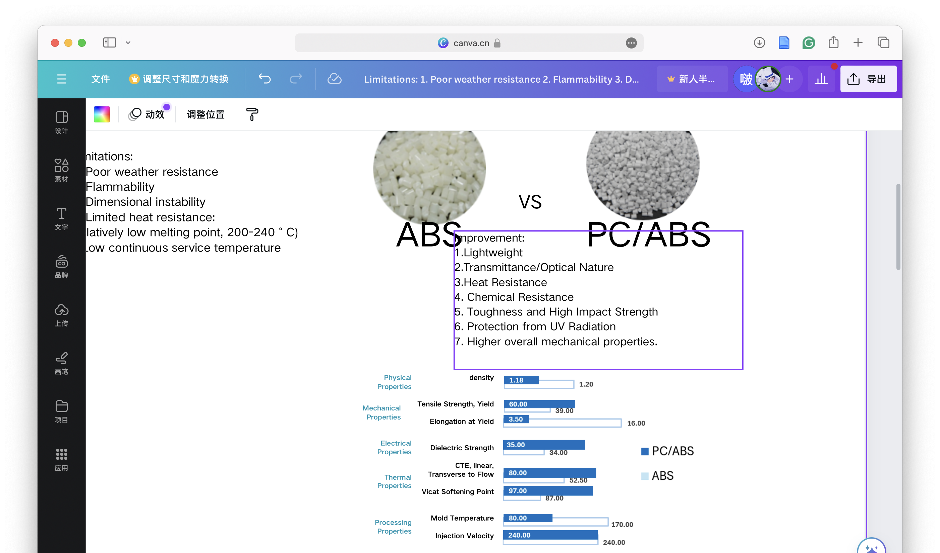
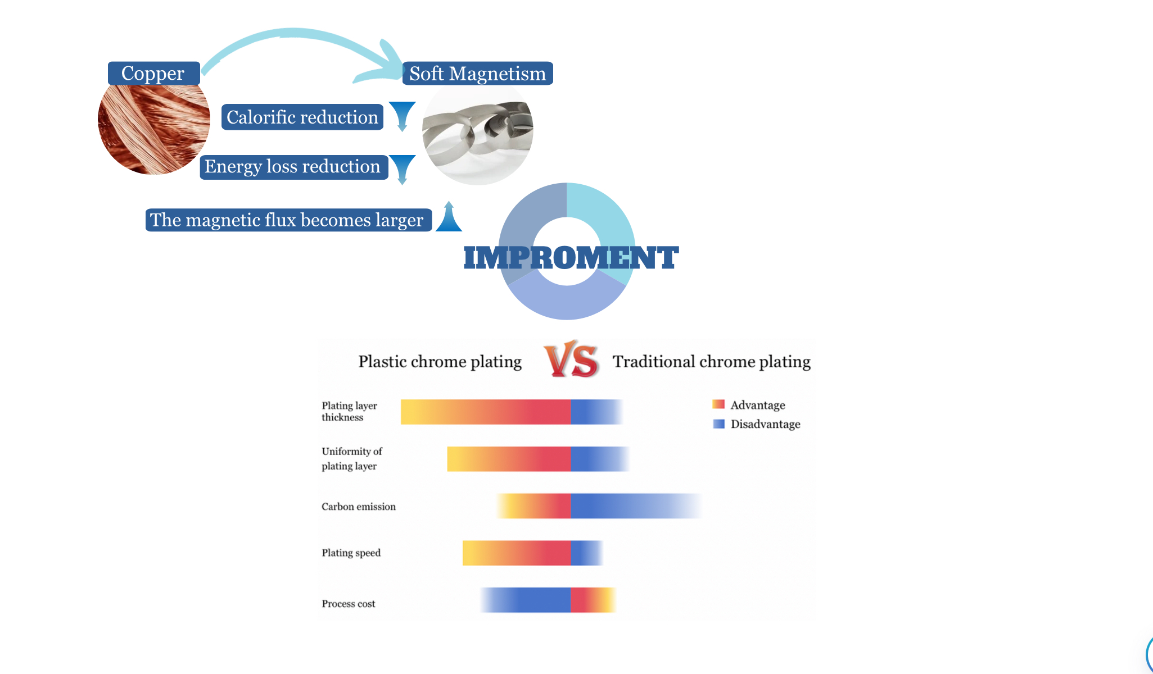
ABS
PC/ABS
Density
1.20
1.18
39.00
60.00
Tensile Strength
87.00
97.00
Vicat Softening Point
170.00
80.00
Mold Temperature
improvement
1.Lightweight
3.Heat Resistance
4. Chemical Resistance
5. Toughness and High Impact Strength
6. Protection from UV Radiation
7. Higher overall mechanical properties

Slide 4
 | Figure |  | Meterial | Property | Failure mode
Outer shell |  |  | ABS | Excellent mechanical properties: 1. High impact strength 2. Dimensional stability 3. Electrical insulation 4. Processability | Higher temperatures: deform or lose its mechanical properties
Engine | ①
 | ②
 | ③ | Stainless steel | Stainless steel | Excellent mechanical properties: 1. High strength 2. Corrosion resistance 3. Plasticity, weldability | 1. tensile stress : crack propagation welding failure 2. temperature and humidity: intergranular / crevice corrosion
 | ④
 | ⑤
 | ⑥ | Copper | Copper | 1. High electrical conductivity 2. Good thermal conductivity 3. Malleability 4. Corrosion resistance | 1. Tensile strength: than 275MPa 2. Elongation δ10 and δ5 are 5% and 10%
 | ⑦ | Ceramic shaft | Ceramic shaft | Durable, corrosion-resistant, lightweight, thermally stable | 1. Intrinsic defects 2. Thermal shock and thermal coupling
Whisk bar |  | Chrome plating | Chrome plating | 1. Good corrosion resistance 2. High hardness 3. Strong heat resistance 4. Excellent wear resistance | 1. High-temperature steam environment, humid environment, pH change, chemical corrosion
 |  | Q195 food grade carbon steel | Q195 food grade carbon steel | Malleability, weldability, rotting resistance, and plasticity | Tensile strength: 315-430 MPa, Elongation: ≥ 33%, Yield strength: 195 Mpa.
Improvement
①Fan
⑤Stator core
②Gear
⑥Rotating shaft
③Rotor core
Rotor wire windings
④Axle
⑦

Slide 5
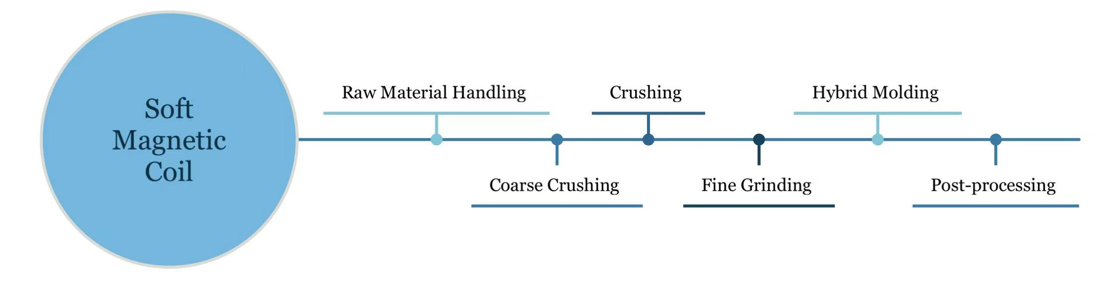
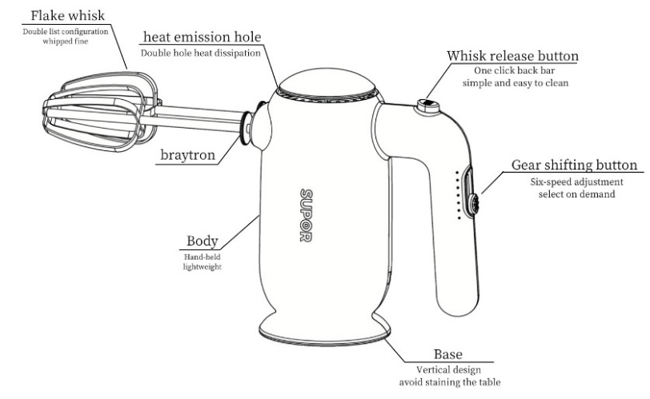
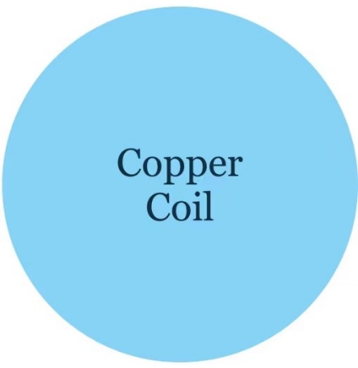
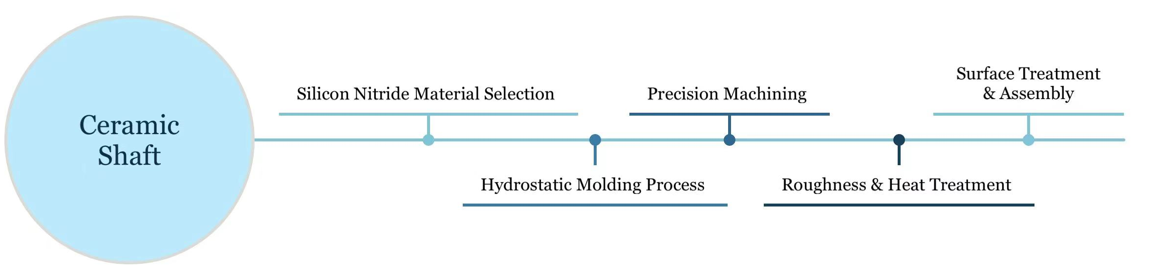
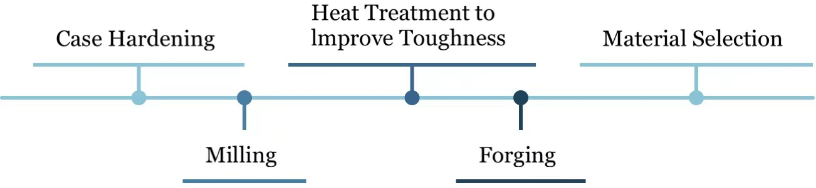
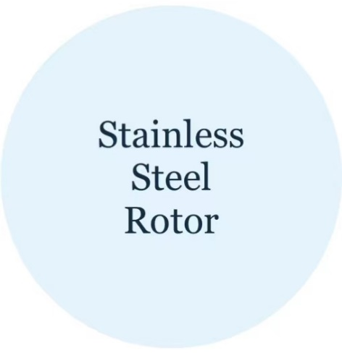

Whisking Towards a Greener Future: Revamping Electric Whisk for Eco-Friendly Innovation
Group number: M18
Group members:
Introduction
Electric whisk, a kind of small handheld device used to whip ingredients, is widely used in home kitchens and small workshops. Our competitor product the SUPOR electric whisk, due to its lightweight, 200W enough power and stir bar push-out button design, has positive feedback from the customers.
However, shortages still exist in SUPOR electric whisk. The
poor heat resistance of the shell, low continuous service temperature, and the high electricity consumption. These drawbacks provide the way of improvement for our innovative electric whisk——environmentally, leading to a more sustainable and long-term usage.
Based on the SUPOR whisk, our innovative electric whisk inherits almost all the design highlights as well as improves its drawbacks. Aiming at a wider range of customers, especially environmentalists who pursue innovation. Despite the slightly increase on price, the excellent performance of our product will ensure its success.
Material &Property & Failure Mode
Improvement
Manufacture
Reference

Slide 6
 | Figure | Meterial | Property | Failure mode
Outer shell |  | ABS | excellent mechanical properties: 1.high impact strength 2.dimensional stability 3.electrical insulation 4.processability | higher temperatures: deform or lose its mechanical properties
Engine | ①
 | ②
 | ③ | Stainless steel | Excellent mechanical properties: 1.High strength 2.Corrosion resistance 3.Plasticity, weldability | 1. tensile stress :crack propagation welding failure 2.temperature and humidity: intergranular and crevice corrosion
 | ④
 | ⑤
 | ⑥ | Copper | 1.High electrical conductivity 2.Good thermal conductivity 3.Malleability 4.Corrosion resistance | 1.Tensile strength:than 275MPa 2.Elongation δ10 and δ5 are 5% and 10%
 | ⑦ | Ceramic shaft | Durable, corrosion-resistant, lightweight, thermally stable | 1.Intrinsic defects 2.Thermal shock and thermal coupling
 | ⑧ | Soft magnetic materials | 1.High permeability 2.Low coercivity 3.Low magnetic loss 4.High magnetic induction | 1.Increase in frequency: decrease in permeability and eddy current loss 2. Alternating magnetic fields produce hysteresis losses 3.High temperature failure above 200°C
Whisk bar |  | Chrome plating | 1.Good corrosion resistance 2.High hardness 3.Strong heat resistance 4.Excellent wear resistance | 1.High temperature steam environment, humid environment, pH change, chemical corrosion
 |  | Q195 food grade carbon steel | Malleability, weldability, rotting resistance, and plasticity | Tensile strength: 315-430 MPa, Elongation:≥ 33%, Yield strength:195 Mpa.
Improvement
①Fan
⑤Stator core
②Gear
⑥Rotating shaft
③Rotor core
⑦Rotor wire windings
④Axle
 | Figure | Meterial | Property | Failure mode
Outer shell |  | ABS | excellent mechanical properties: 1.high impact strength 2.dimensional stability 3.electrical insulation 4.processability | higher temperatures: deform or lose its mechanical properties
Engine | ①
 | ②
 | ③ | Stainless steel | Excellent mechanical properties: 1.High strength 2.Corrosion resistance 3.Plasticity, weldability | 1. tensile stress :crack propagation welding failure 2.temperature and humidity: intergranular and crevice corrosion
 | ④
 | ⑤
 | ⑥ | Copper | 1.High electrical conductivity 2.Good thermal conductivity 3.Malleability 4.Corrosion resistance | 1.Tensile strength:than 275MPa 2.Elongation δ10 and δ5 are 5% and 10%
 | ⑦ | Ceramic shaft | Durable, corrosion-resistant, lightweight, thermally stable | 1.Intrinsic defects 2.Thermal shock and thermal coupling
 | ⑧ | Soft magnetic materials | 1.High permeability 2.Low coercivity 3.Low magnetic loss 4.High magnetic induction | 1.Increase in frequency: decrease in permeability and eddy current loss 2. Alternating magnetic fields produce hysteresis losses 3.High temperature failure above 200°C
Whisk bar |  | Chrome plating | 1.Good corrosion resistance 2.High hardness 3.Strong heat resistance 4.Excellent wear resistance | 1.High temperature steam environment, humid environment, pH change, chemical corrosion
 |  | Q195 food grade carbon steel | Malleability, weldability, rotting resistance, and plasticity | Tensile strength: 315-430 MPa, Elongation:≥ 33%, Yield strength:195 Mpa.
Improvement

Slide 7
